Slide 1
Early detection of Alzheimer’s using Brain MRI scans
Akshay Iyer
Yuchen Shen
Omkar Kulkarni
Shengmei Liu

Slide 2
The dark world of Alzheimer’s...
44
million people worldwide have Alzheimer’s or a related dementia
6th
leading cause of death in the US
605
billion$ is the global cost of Alzheimer’s and Dementia
Most effective when treated early
Notes:
Welcome to the world of Alzheimers’s - a disease which is very elusive to detect and treat

Slide 3

http://media.medicalbag.com/images/2016/02/09/what-makes-you-angry.jpg/
Notes:
Meet John, he is a doctor in a leading hospital. Today he is in a bad mood since he had a fight with his teenage son. Now in this mood, he has to look through several reports and diagnostics and account for a lot of variables to detect the elusive Alzheimer’s. He is not in the best state of mind, how accurately do you think he’ll be able to make the prediction? Mind you, a wrong judgement here could severely affect the quality of life of a person.

Slide 4
Helping Johns around the world...
Currently,
No single test to detect Alzheimer’s always
Multiple metrics but lack of clarity
Scope for improved decision making
We propose: Machine learning to augment capabilities of doctors
Past successes: Google (tumors on mammograms) | Stanford (skin cancer)
Factor in multiple important features and eliminate human bias
ML for Alzheimer’s → small datasets and mostly predicts healthy or diseased
We help early detection - predict Mild cognitive impairment
Notes:
Currently: as is
Multiple assessment metrics like clinical data, medical history, MRI scans but lack of clarity on most important features

Slide 5
How do we do it?

Slide 6

Classifier
Alzheimer’s
Cleanse
Mild Cognitive Impairment
Normal Condition
Random Forests
Support Vector Machines
Gaussian Process Classification
Artificial Neural Networks
Logistic Regression
Bagging
Ada boosting
Gradient Boosting
Ensemble - Majority Voting
Convolutional Neural Network
Individual models
Ensemble models
Deep learning model
Notes:
The approach we have followed is to do a comparative analysis between various machine learning models. We use the data from the ADNI - Alz disase neuroimaging initiative and feed it to various machine learning algorithms. We have implemented the classical ML algorithms like Random forests, SVM, Gaussian Process Classification, ANN and Logistic Regression. We went on to implement ensemble methods like bagging for Logistic and bagging for SVM, Ada boosting, gradient boosting. We also tried several combinations of individual classifiers using majority voting. Finally we trained a convolutional neural network with the brain MRI scans and tried to predict if a given patient has Alzheimer’s, is likely to develop it or is healthy. I call upon Omkar to take you through the story of helping John making better predictions and we’ll reveal the suspense hero at the end. Stay tuned...

Slide 7
Classifier
Alzheimer’s
Cleanse
Mild Cognitive Impairment
Normal Condition
Random Forests
Support Vector Machines
Gaussian Process Classification
Artificial Neural Networks
Logistic Regression
Bagging
Ada boosting
Gradient Boosting
Ensemble - Majority Voting
Convolutional Neural Network
Individual models
Ensemble models
Deep learning model
Notes:
The approach we have followed is to do a comparative analysis between various machine learning models. We use the data from the ADNI - Alz disase neuroimaging initiative and feed it to various machine learning algorithms. We have implemented the classical ML algorithms like Random forests, SVM, Gaussian Process Classification, ANN and Logistic Regression. We went on to implement ensemble methods like bagging for Logistic and bagging for SVM, Ada boosting, gradient boosting. We also tried several combinations of individual classifiers using majority voting. Finally we trained a convolutional neural network with the brain MRI scans and tried to predict if a given patient has Alzheimer’s, is likely to develop it or is healthy. I call upon Omkar to take you through the story of helping John making better predictions and we’ll reveal the suspense hero at the end. Stay tuned...

Slide 8
Methodology

Slide 9

Dataset Description
ADNI - Alzheimer’s Disease Neuroimaging Initiative
Two Types of Data : Processed Image Data and Original Image Data.
The brain status which are CN, AD and MCI, is our prediction goal/output classes.
To handle shortcomings of small data set, we applied bootstrapping and generated more training samples.
Image Source : http://adni.loni.usc.edu/

Slide 10
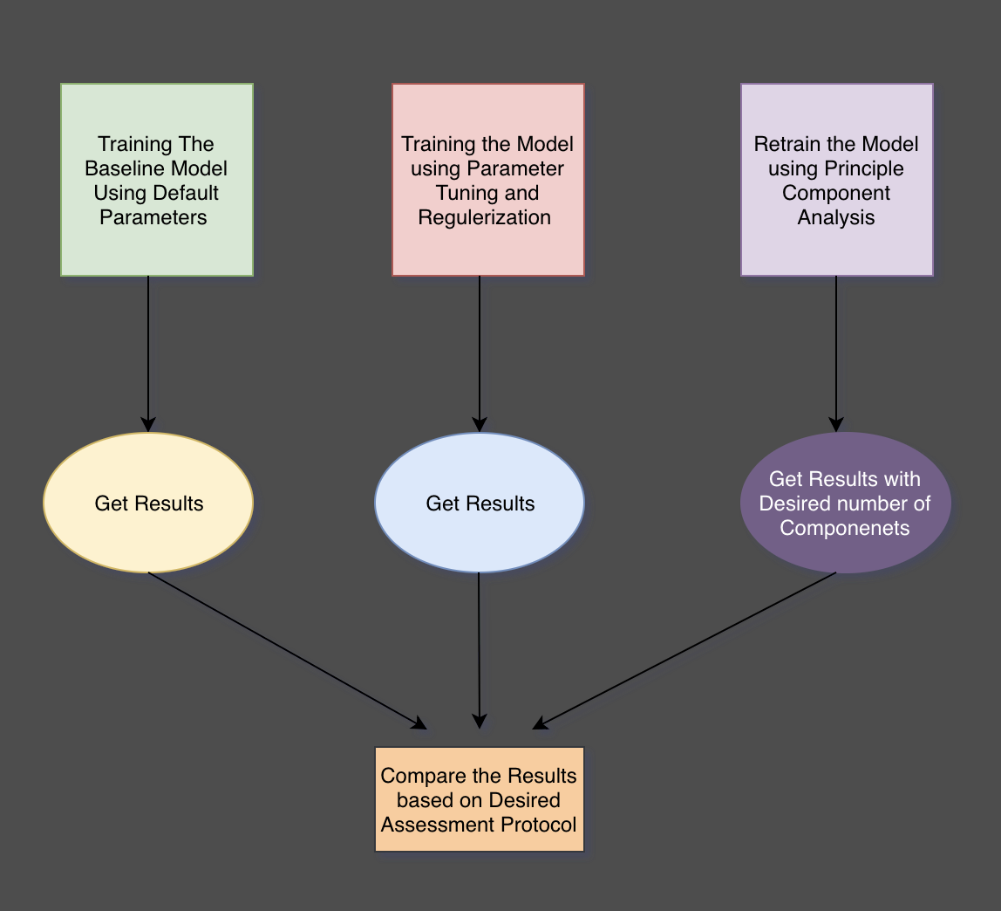
Approach Used

Slide 11
Train the baseline model
Train model after parameter tuning and regularization
Retrain model after principal component analysis
Get results
Get results
Get results with reduced features
Compare results based on assessment protocol

Slide 12
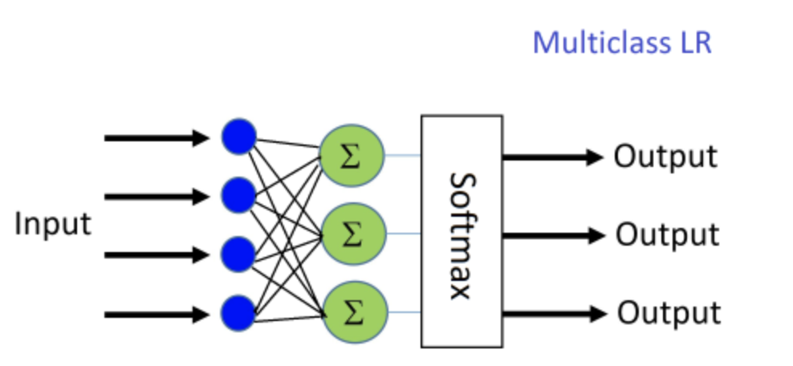
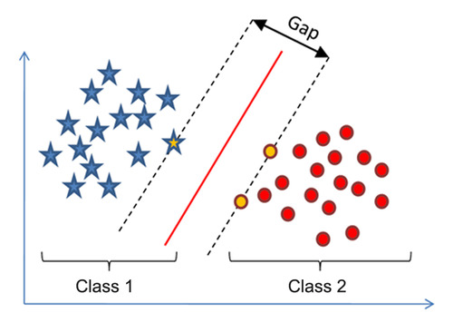
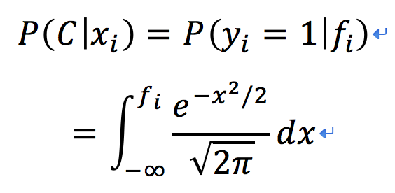
Logistic Regression :
Classification algorithm used to assign observations to a discrete set of classes.
SVM :
Classification Algorithm which given labeled training data,
outputs an optimal hyperplane which categorizes new examples.
Random Forest :
Random Forest is ensemble learning method which uses multitude of decision trees for training.
Min_samples_split = 12, n_estimators = 250, min_samples_leaf = 5, max_depth = 10
Gaussian Processing Classification :
nonparametric classification method
Posterior probabilities is given by
Image Source : https://cntk.ai/pythondocs/CNTK_103B_MNIST_LogisticRegression.html http://diggdata.in/post/94066544971/support-vector-machine-without-tears

Slide 13
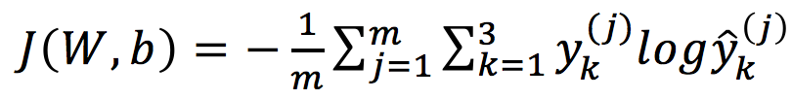
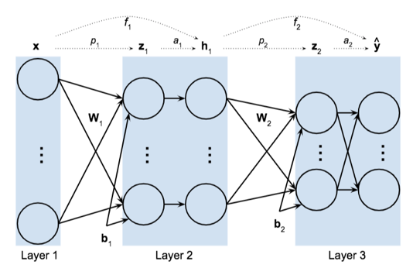
Artificial Neural Network :
The network we are using implement the function f : R2158→R3.
The cost function is cross entropy given by :
For Parameter Tuning in ANN, we tried different
number of units in the hidden layer, variation in
learning rate, minibatch size and regulation
strength, etc.
Image Source : WPI Coursework

Slide 14
Ensemble Learning
Bagging
Boosting
Ada Boosting
Gradient Boosting
Ensemble Model
Notes:
So based on all these individual model, we tried the ensemble learning method, including bagging, boosting and Ensemble models. And in boosting, we train ada boosting and gradient boosting.

Slide 15
Bagging
Samples
Features
Bootstrap
Subset
training set 1
training set N
….
Logistic Regression & SVM
Notes:
For bagging approach, the basic idea is to generate several different train set from the original one. Here, we use bootstrap and use different subset of features to create new training set. Then for each set, we train classifier and using max-voting to get the final result.
LR and SVM is the base classifier here.

Slide 16
Boosting
Weak Classifier
Strong Classifier
Notes:
Overcome the shortcoming from the samples

Slide 17
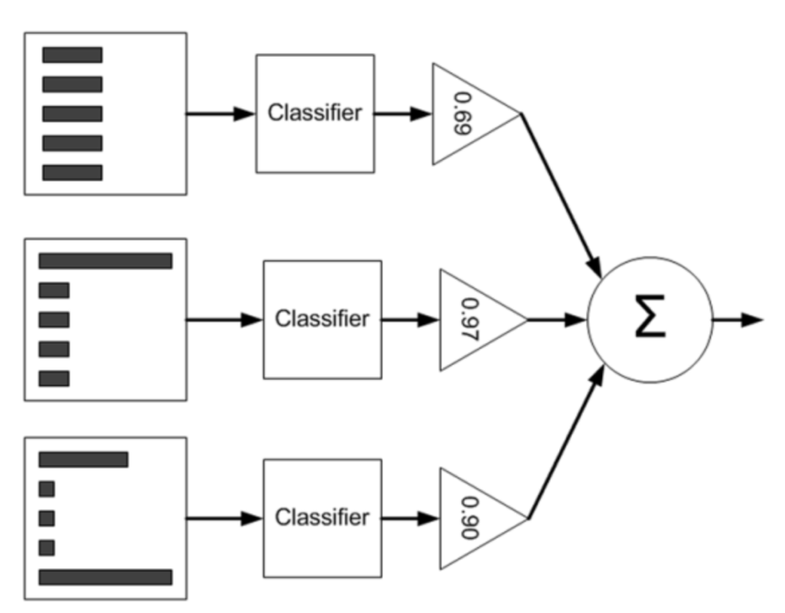
Ada Boosting
Logistic Regression
Decision Tree
(https://blog.csdn.net/qilinxo/article/details/72935464)
Notes:
Like this example, we have 5 samples. For the first step, we feed samples with same weight into a weak classifier, train the classifier and generate the result. So some samples can be correctly classified and others are not. For those incorrect classified samples, we will give them higher weight in the next step. In the next step, yo can see the first sample, higher weight. Repeat these process several times to train different classifier. And in each step we will have the weight of the classifier based on the classification result.
When test a new sample, just feed the sample into every classifier, and generate the result by weighted average.
Adaboost is to overcome the high weighted incorrect classified problem.
Similarly,gradient boosting algorithm is to repetitively leverage the patterns in residuals and strengthen a model with weak predictions and make it better. Once we reach a stage that residuals do not have any pattern that could be modeled, we can stop modeling residuals

Slide 18
Ensemble Model
Gaussian Process Classifier
Logistic Regression
Random Forest
SVM
Max-Voting
Notes:
Ensemble methods use multiple learning algorithms to obtain better predictive performance than could be obtained from any of the constituent learning algorithms alone. Feeding the data into several different models, and using max-voting to generate the final result.

Slide 19
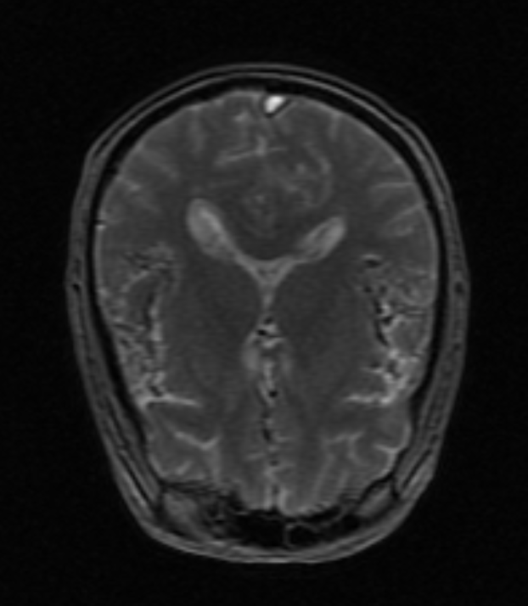
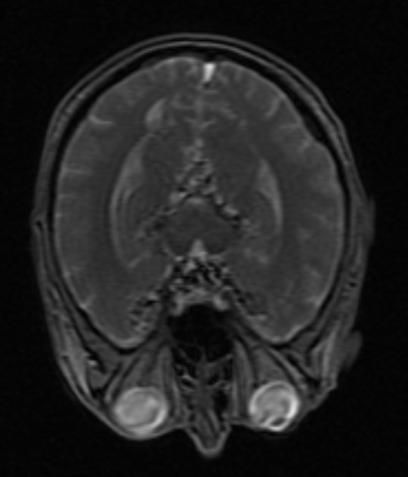
Image Data
Notes:
Since all the processed data is generated from the brain image, what if we can classified based on this original data. Almost every image preprocess method can lost some information, and deteriorates the performance.

Slide 20
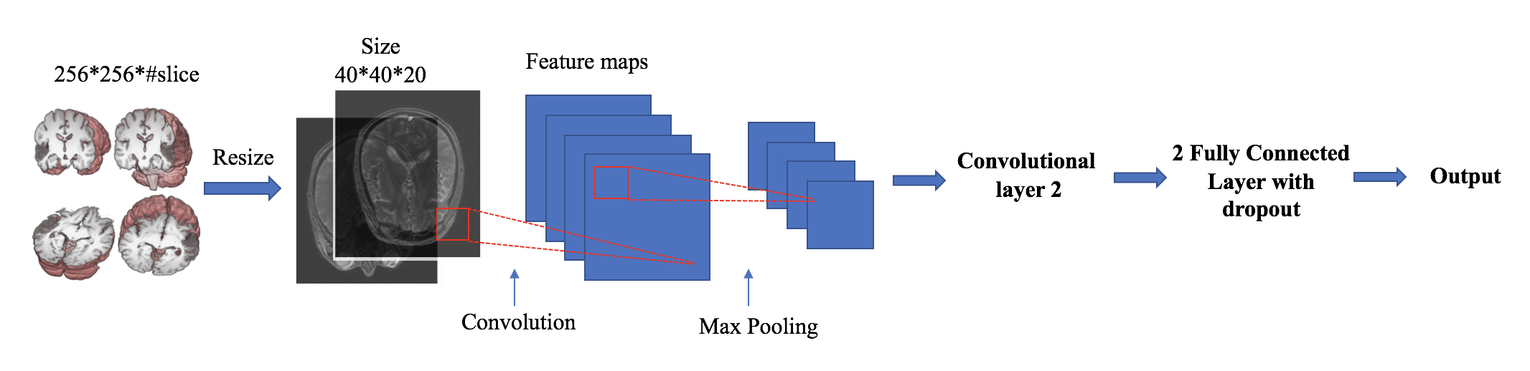
Convolutional Neural Network
(http://nipy.org/nibabel/neuro_radio_conventions.html)
Notes:
Then, we create a CNN to work on the original image.
Medical brain image is a 3-D image, consist of many scanning slice. The 3 dimensional matrix can be really huge.
Due to the computational power, we resize the 3-D image into 40 by 40 and use only 20 slice in the middle. Then we create a NN with 2 convolutional layer followed by 2 fully connected layer.
Convolution is to use a kernel to extract information from the original image and max pooling is to leave the most important information and drop the others.
Output is probability of classified to each class.

Slide 21
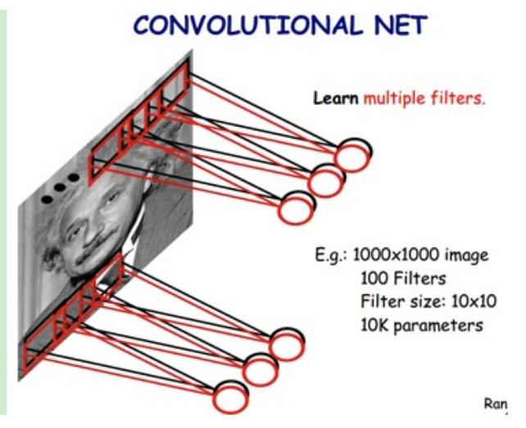
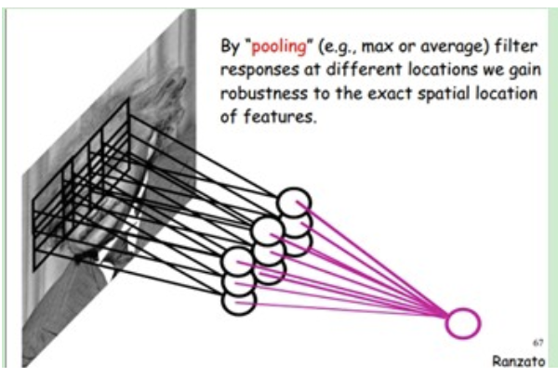
Convolution and Max Pooling
(http://blog.csdn.net/zouxy09/article/details/8781543)
Notes:
We can have a better view here. What we are training updating is the kernel

Slide 22
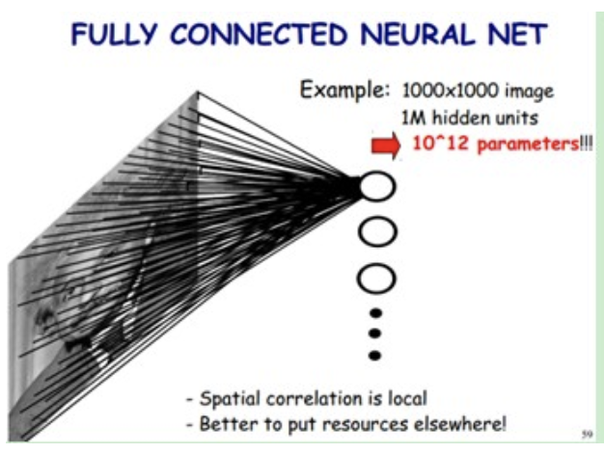
Fully Connected Layer
(http://blog.csdn.net/zouxy09/article/details/8781543)
Notes:
To overcome overfitting, we use dropout in the fully connected layer. It is a method to randomly not use some neurals in each iteration, this like randomly set the parameter into 0.

Slide 23
Evaluation Metrics
Accuracy: Important for Classification Problem.
F1-Score: The processed data is not balanced with 20% AD, 30%, CN and 50% MCI.
Notes:
That’s all model we have tried, and to evaluate the performance, accuracy and f1 score is helpful. Since
Combination
Shenmei

Slide 24
Results & Conclusions
Notes:
Thanks Yuchen, This is shengmei, and Now it’s my turn to talk about results and conclusions

Slide 25
Table 1: Performance of the classifiers without PCA
Classifier | Performance metric
 | Accuracy Score | F1 score
Logistic Regression (LR) | 0.4921 | 0.4829
Support Vector Machines (SVM) | 0.5556 | 0.5174
Random Forests (RF) | 0.6587 | 0.5916
Gaussian Process Classification (GPC) | 0.5397 | 0.2337
Artificial Neural Networks | 0.4841 | 0.4559
Bagging - Logistic Regression | 0.4762 | 0.4682
Bagging - SVM | 0.5159 | 0.3016
Ensemble (LR + RF + SVM) | 0.5159 | 0.4670
Ensemble (LR + RF + SVM + GPC) | 0.5625 | 0.5137
Ensemble (LR + RF + GPC) | 0.4932 | 0.4873
Ada boosting - Decision trees | 0.5793 | 0.5909
Ada boosting - LR | 0.5079 | 0.5104
Gradient Boosting | 0.6904 | 0.6897
Notes:
We implemented bunch of algorithms and this table shows the performance of the classifiers with accuracy and F-1 score. In which gradient boosting gives best accuracy for processed data, it is 69 percent.

Slide 26
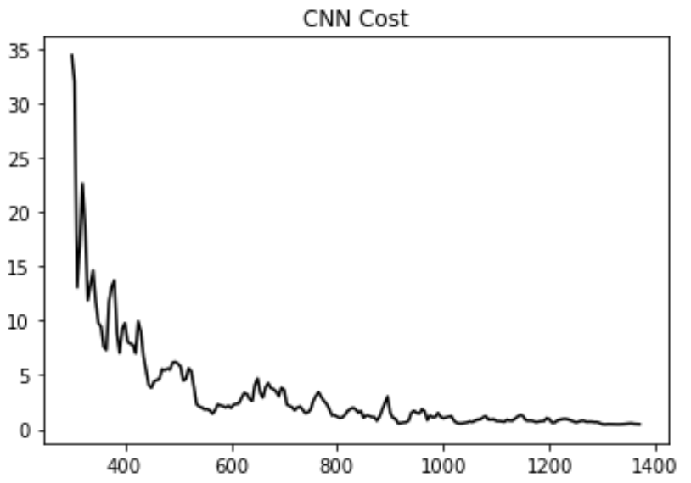
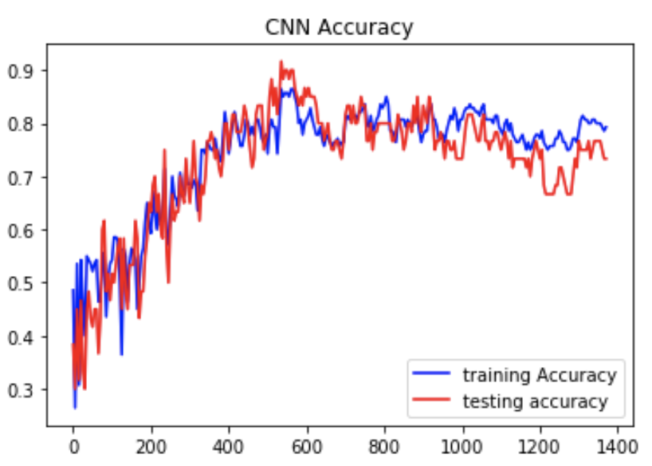
Convolutional neural network results
Convolutional neural network Training Cost CNN Training and Testing Accuracy
The accuracy of CNN is 75.67%
Notes:
Using original brain image data, we generate the convolutional neural network classification model with the accuracy around 75%. The training cost decreased when we trained more while the accuracy became stable. Basically, CNN and gradient boosting will help Johns all over the world detecting Alzheimer’s.

Slide 27
Summary of results
Improved accuracy over similar state of the art models
Highest accuracy on processed data ----- Gradient Boosting
Bad models - potentially deteriorated the performance in the ensemble model
MMSE - found to be the most important feature --- agrees with the current diagnostic standards
Education --- found to have negligible importance compared to other more important features
Convolutional Neural Network worked on the images ---- improved accuracy
Notes:
This is the summary of our results:
1.We have improved accuracy over similiar state of the art models, by 10%.
2. Highest accuracy on processed data is obtained by Gradient Boosting.
3. Although all ensemble models include random forest which gives extraordinary individual accuracy, the result of ensemble models is much lower than RF. It indicates bad models can potentially deteriorate the performance of a high model in the ensemble model.
4. Mini Mental State Examination (MMSE) - found to be the most important feature, it agrees with the current diagnostic standards.
5. Surprisingly, Education found to have very small importance compared to other more important features.
6. CNN works better than all models generated from processed data, which indicates the strength of CNN.

Slide 28
What do experts have to say...
… this is great work and would be very interesting to see how it can be extended to other diseases like TBI
Dr. Nephew, WPI
… this would be of great help, especially education not being a very important metric is a very exciting result and would love to explore it deeper
Dr. Serj, UMass Medical School and WPI
Notes:
Finally, We have talked to couple experts in neural science area, this is what they have to say about our project:

